Slide 1
CREDIT CARD FRAUD DETECTION
- Durgesh Kekare

Slide 2
PROBLEM STATEMENT
In the banking industry, detecting credit card fraud using machine learning is not just a trend, It is a necessity for the banks, as they need to put proactive monitoring and fraud prevention mechanisms in place.
Machine learning helps these institutions reduce time-consuming manual reviews, costly chargebacks and fees, and denial of legitimate transactions.
Credit card fraud is any dishonest act or behavior to obtain information without the proper authorization of the account holder for financial gain. Among the different ways of committing fraud, skimming is the most common one.
You need to develop a machine learning model to detect fraudulent transactions based on the historical transactional data of customers with a pool of merchants.

Slide 3
DATA UNDERSTANDING
The data set contains credit card transactions of around 1,000 cardholders with a pool of 800 merchants from 1 Jan 2019 to 31 Dec 2020. It contains a total of 18,52,394 transactions, out of which 9,651 are fraudulent transactions.
The feature 'amt' represents the transaction amount. The feature 'is_fraud' represents class labelling and takes the value 1 the transaction is a fraudulent transaction and 0, otherwise.
Data Source: https://www.kaggle.com/datasets/kartik2112/fraud-detection

Slide 4
PROCESS FLOW
Understanding Data
Exploratory Data Analytics (EDA)
Train/Test Data Splitting
Model Building or Hyper Parameter Tuning
Model Evaluation
Business Impact

Slide 5
CHALLENGES INVOLVED IN CREDIT CARD FRAUD DETECTION
Enormous Data is processed every day and the model build must be fast enough to respond to the scam in time.
Imbalanced Data i.e most of the transactions (99.8%) are not fraudulent which makes it really hard for detecting the fraudulent ones
Data availability as the data is mostly private.
Misclassified Data can be another major issue, as not every fraudulent transaction is caught and reported.
Adaptive techniques used against the model by the scammers.

Slide 6
HOW TO TACKLE THESE CHALLENGES?
The model used must be simple and fast enough to detect the anomaly and classify it as a fraudulent transaction as quickly as possible.
Imbalance can be dealt with by properly using some methods which we will talk about in the next slide
For protecting the privacy of the user the dimensionality of the data can be reduced.
A more trustworthy source must be taken which double-check the data, at least for training the model.
We can make the model simple and interpretable so that when the scammer adapts to it with just some tweaks we can have a new model up and running to deploy.

Slide 7
UNDERSTANDING DATA
We have given 2 Datasets: Test Dataset & Train Dataset
Train Dataset Contains 12,96,675 Rows & 23 Columns whereas Test Dataset contains 5,55,719 Rows & 23 Columns
While Determining number of fraud cases in dataset
1. Train Dataset contains 99.42% Non Fraud cases and 0.58% Fraud Cases.
2. Test Dataset contains 99.61% Non Fraud cases and 0.39% Fraud Cases.
It indicates that Data is highly Unbalanced.

Slide 8
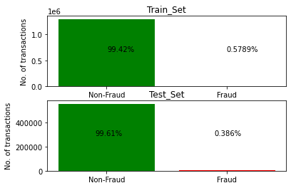
Data Understanding

Slide 9
EXPLORATORY DATA ANALYTICS (EDA)
In this, first step is to find the distance of customer location from merchant location
After that we have to check the Categorical Variables if there are any highly skewed variables.
Next to that we have drop the variables which are not useful for model building
Creating Dummy Variables for Category is necessary here.

Slide 10
MODEL BUILDING
For Model Building we split the Dataset into X & Y
To remove the effect of highly imbalanced data we did Over Sampling
For that we imported ADASYN
1st Model Building Method: Random Forest Model
1. Out of bag (OOB) score is a way of validating the Random forest model.
2. In the Random Forest model, the original training data is randomly sampled-with
replacement generating small subsets of data
3. The OOB_score is computed as the number of correctly predicted rows from the out-of-bag sample.

Slide 11
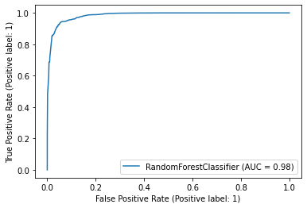
In this model building method we have achieved 0.93 oob_score.
Sample Curve Generated by plot_roc_curve:

Slide 12
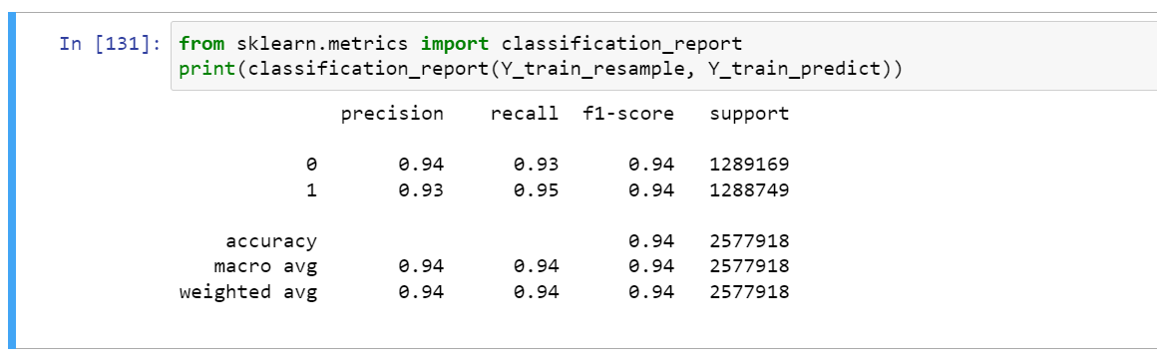
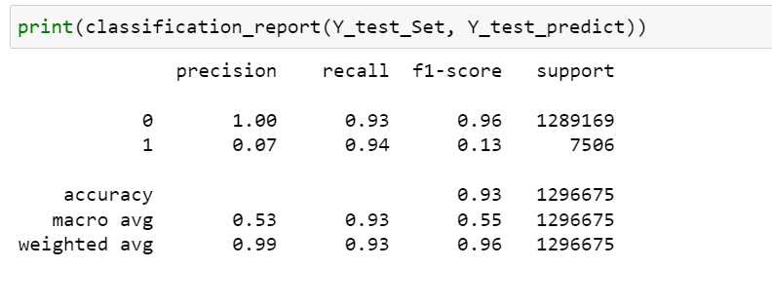
MODEL EVALUATION
Model Prediction on Train Set
Model Prediction on Test Set

Slide 13
TESTING MODEL ON ORIGINAL DATA WITHOUT OVERSAMPLING

Slide 14
BUSINESS IMPACT
After the model has been built and evaluated with the appropriate metrics, we need to demonstrate its potential benefits by performing a cost-benefit analysis.
To analyze the cost benefits we have compared the costs incurred before and after the model is deployed.
From this analysis we can conclude that the business is in profit or in loss.

Slide 15
COST BENEFIT ANALYSIS
According to the analysis we have got below stats for the same:
S. No | Questions | Answer
a | Average number of transactions per month | 77183
b | Average number of fraudulent transaction per month | 402
c | Average amount per fraud transaction | 531

Slide 16
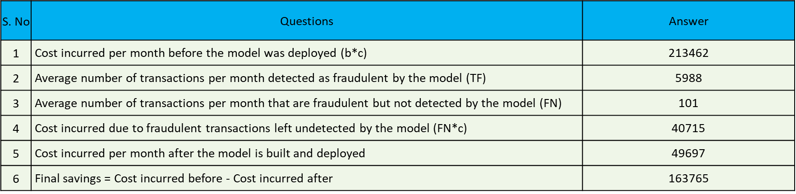
Cost Incurred per month by the bank before and after the model deployment:

Slide 17
THANK YOU

